Slide 1

Real Time Class Feedback APP
Dan Frederick
Spring 2021

Slide 2
Problem Statement
Teaching in the virtual format sucks:
It is difficult to read your student’s body language to figure out if they understand the context
There is not a good method of polling for understanding
Some students do not ask questions because they are afraid of looking dumb

Slide 3
Solution
Real Time Class Feedback
A Xamarin (cross-platform .NET application) to allow for communicating with the class is real time.
Student voting on understanding of material with visualization
Messaging that allows for the instructor to highlight messages, fade out read messages, and students to anonymously submit messages
(Future) Instructor’s tool to send multiple choice questions to the class and check responses to test understanding

Slide 4
Design
User Interface built in XAML (4 Pages)
Welcome
Room Creator Setup
User Setup
Class Room
Backend code built in C#
Utilized for all event handling, establishment of object data types
Rest Architecture for server-client synchronization
Post
Get
Put
Delete

Slide 5
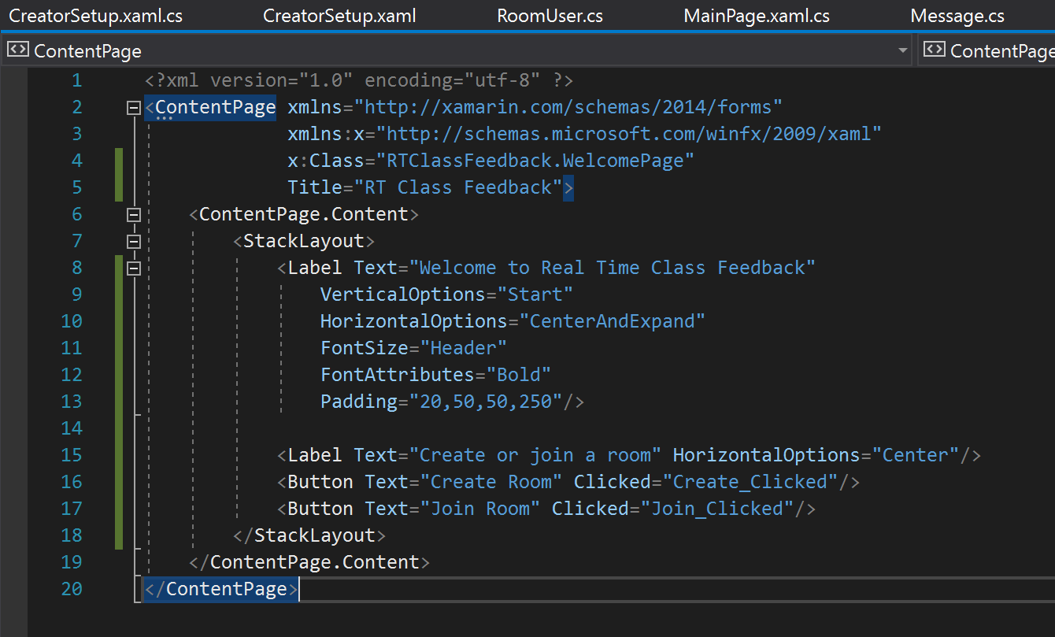
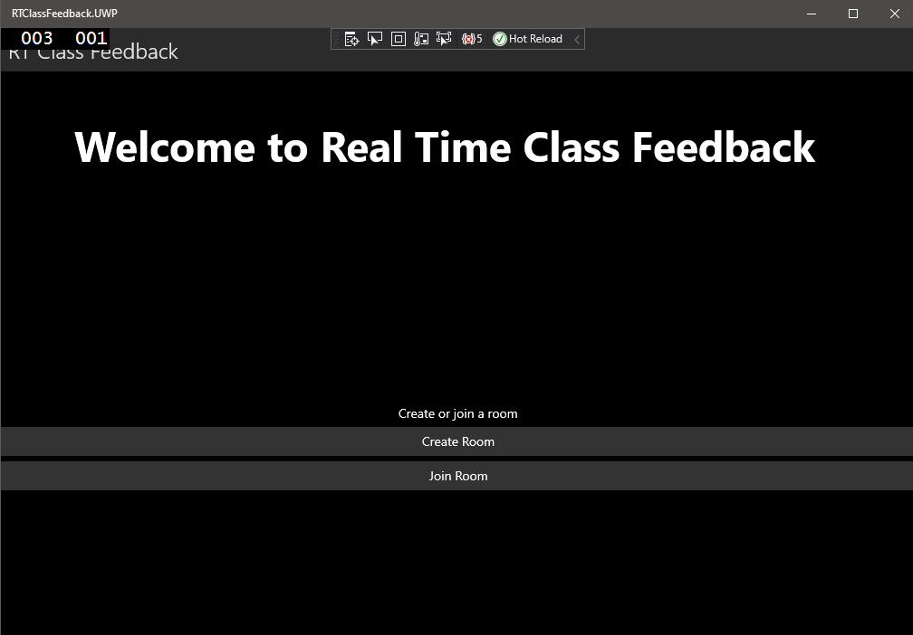
UI

Slide 6
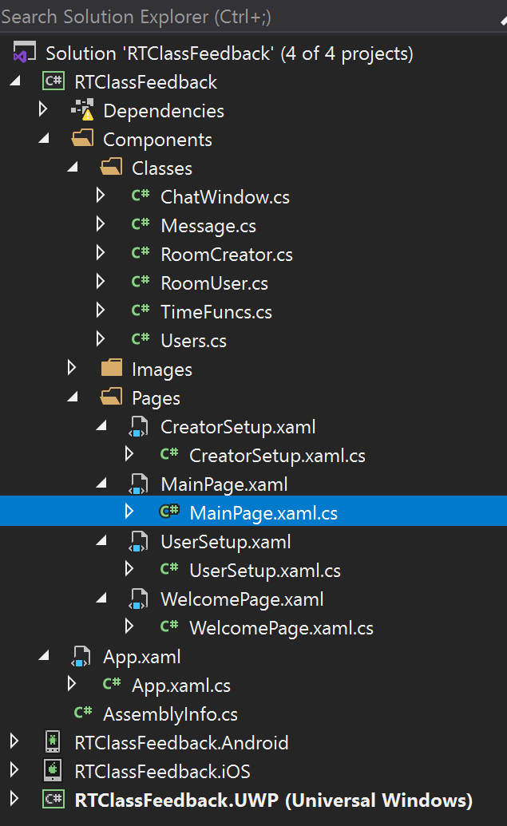
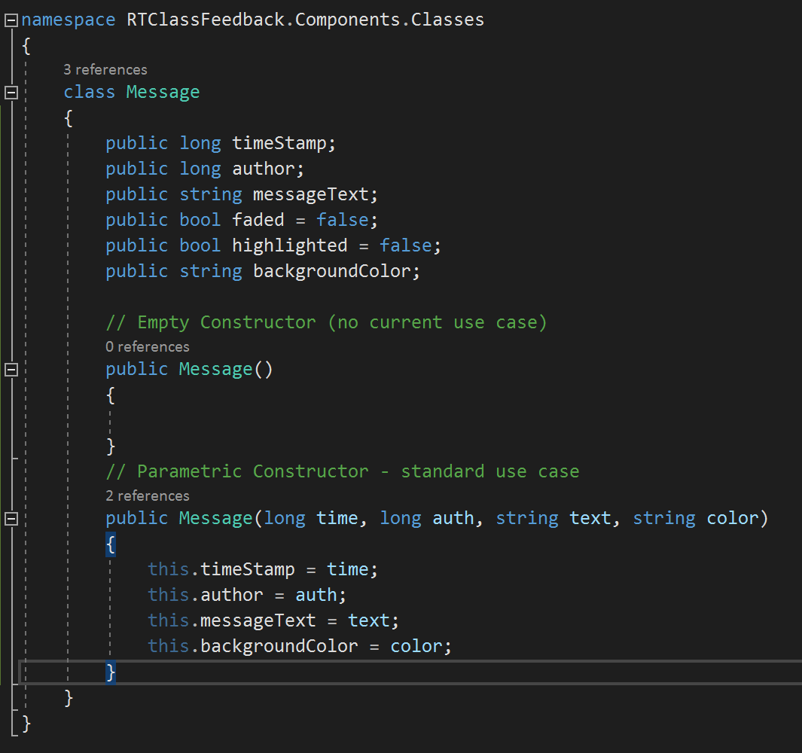
Backend

Slide 7
Rest
User Interface built in XAML (4 Pages)
Welcome
Room Creator Setup
User Setup
Class Room
Backend code built in C#
Utilized for all event handling, establishment of object data types
Rest Architecture for server-client synchronization
Post
Get
Put
Delete

